Slide 1
Powder Metallurgy
By prof.A.Chandrashekhar

Slide 2
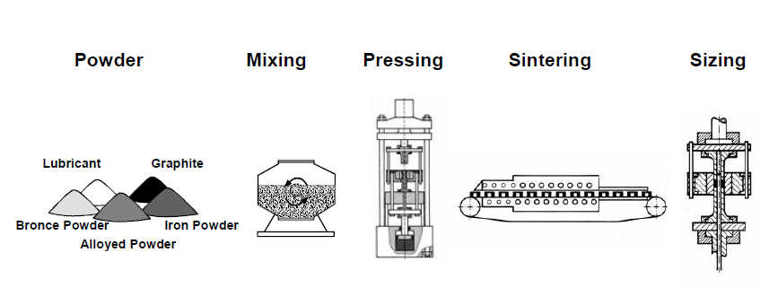
Powder Metallurgy Manufacturing process
Production of metal powders
Mixing of powders
Compaction
Sintering
Secondary Operations

Slide 3
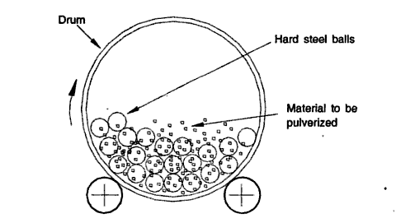
A ball mill for producing metal powder

Slide 4
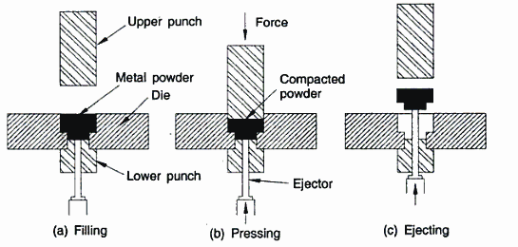
Compaction of powder metal

Slide 5
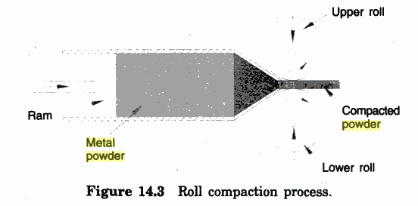
Roll Compaction process

Slide 6
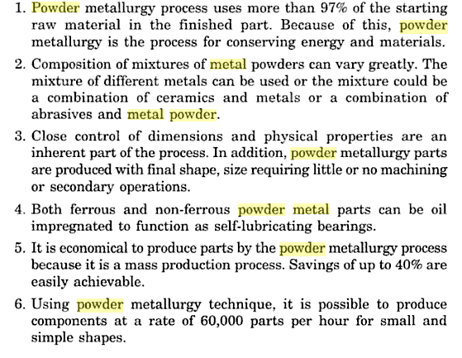
Advantages

Slide 7
Limitations

Slide 8
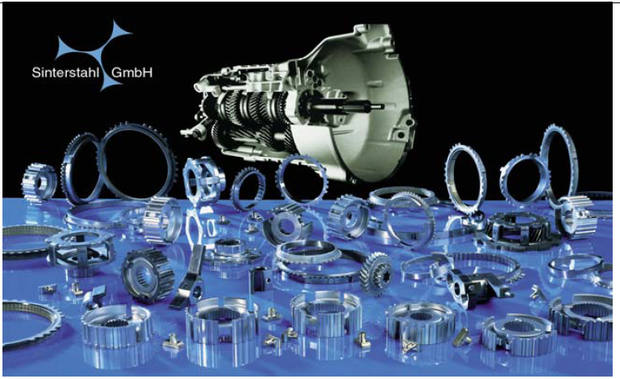

Slide 9
